Slide 1
Quiz Society
Week 1

Slide 2
Rules
Get into teams of 1-4 people
Have a piece of paper, a writing implement, and a team name prepared
There will be 5 rounds, with 6 questions per round
3 minutes per round
The team with the most points at the end wins

Slide 3
ROUND 1
PILOT EPISODES

Slide 4
NAME THE TV SHOW, WHEN GIVEN ITS PILOT EPISODE
WINTER IS COMING
I CHOOSE YOU!
YESTERDAY’S JAM
AN UNEARTHLY CHILD
RED LIGHT, GREEN LIGHT
MUDDY PUDDLES

Slide 5
ROUND 2
PRIDE
FLAGS

Slide 6






NAME THE PRIDE FLAGS
2.
4.
6.
1.
3.
5.

Slide 7
ROUND 3
CHEMICAL ELEMENTS
By the origin of their names

Slide 8
NAME THE CHEMICAL ELEMENT, WHEN GIVEN THE ORIGIN OF ITS NAME AND ATOMIC NUMBER
WATER FORMING(1)
CYPRUS(29)
GOBLIN(27)
FATHER OF THE TITANS(92)
DISCOVERER OF THE THEORY OF RELATIVITY (99)
NEW(10)

Slide 9
ROUND 4
COUNTRIES

Slide 10
DOUBLE
TROUBLE

Slide 11
NAME TWO COUNTRIES THAT:
BEGIN WITH THE LETTER J
ARE DOUBLE LANDLOCKED
ONLY BORDER ITALY
HAVE THE SAME FLAG
HAVE A POPULATION GREATER THAN 1 BILLION
HAVE THE WORD “ISLANDS” IN THEIR NAME

Slide 12
ROUND 5
HISTORY
OF MURDERERS

Slide 13
NAME THE HISTORICAL FIGURE, WHEN GIVEN THE ONE THAT KILLED THEM
JOHN WILKES BOOTH
GAVRILO PRINCIP
JAMES EARL RAY
BIG ROCK FROM SPACE
BRUTUS, CASSIUS, ETC
MARK CHAPMAN

Slide 14
SWAP YOUR PAPERS, IT’S ANSWER TIME
BONUS ROUND

Slide 15
MISSING LINK

Slide 16

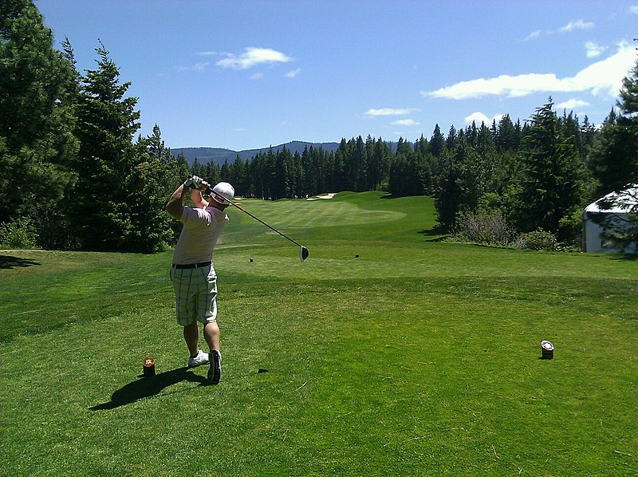


WHAT’S THE LINK?

Slide 17
SWAP YOUR PAPERS, IT’S ANSWER TIME

Slide 18
ROUND 1
GAME OF THRONES
POKEMON
THE IT CROWD
DOCTOR WHO
SQUID GAME
PEPPA PIG

Slide 19
ROUND 2
TRANSGENDER
LESBIAN
BISEXUAL
2.
4.
6.
GENDERFLUID
ASEXUAL
PANSEXUAL
1.
3.
5.

Slide 20
ROUND 3
HYDROGEN
COPPER
COBALT
URANIUM
EINSTEINIUM
NEON

Slide 21
ROUND 4 – 2 CORRECT ANSWERS NEEDED TO SCORE A POINT
JAMAICA, JAPAN, JORDAN
LIECHTENSTEIN, UZBEKISTAN
VATICAN CITY, SAN MARINO
INDONESIA, MONACO, ROMANIA, CHAD
CHINA, INDIA
MARSHALL ISLANDS, SOLOMON ISLANDS

Slide 22
ROUND 5
ABRAHAM LINCOLN
FRANZ FERDINAND
MARTIN LUTHER KING JR.
THE DINOSAURS
JULIUS CAESAR
JOHN LENNON

Slide 23
THE LINK IS “LINK”
WEAKEST LINK “HITTING THE LINKS” – PLAYING GOLF LINK(LEGEND OF ZELDA) LINKIN PARK

Slide 24
COUNT UP THE MARKS
RETURN THE PAPERS TO THEIR ORIGINAL TEAMS
ALL TEAMS REPORT YOUR SCORES
WAIT PATIENTLY WHILE A WINNER IS DECIDED
REVEL IN JOY IF YOU WIN

Slide 25
THE TOP 3 TEAMS MAY EACH SELECT A CATEGORY FOR NEXT WEEK’S QUIZ
A CATEGORY CANNOT BE SELECTED WITHIN TWO WEEKS OF IT BEING USED
AS FOR EVERYBODY ELSE, THANK YOU FOR COMING ALONG

